Slide 1
Fast set Intersection using Baeza-Yates Algorithm
Presented By,
SRINIVAS KASTURI
03/27/2017

Slide 2
Agenda
Set Intersection
Related Work
Introduction
Problem
A New Algorithm and Its Analysis
Implementation in c++
Experimental Results
Applications
Conclusions

Slide 3
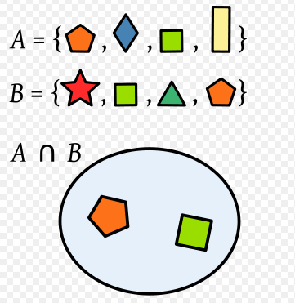
SET INTERSECTION
In mathematics, the intersection A ∩ B of two sets A and B is the set that contains all elements of A that also belong to B (or equivalently, all elements of B that also belong to A), but no other elements.

Slide 4
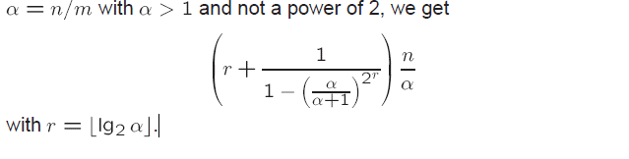
Related Work
Lower bounds for the element uniqueness problem and merging (sorted case) do not apply to the multiple search problem (but the converse is true).
Fernandez de la Vega et al. (1998) analyzed the average case of a simplified version of Hwang-Lin’s binary merge (1972) finding that if
Adaptive multiple set intersection algorithm (Demaine et al., 2000 & 2001). They also defined the difficulty of a problem instance, which was refined later by Barbay and Kenyon (2002).

Slide 5
Introduction
Multiple searching:
Given an n-element data multi set, D , drawn from an ordered universe, search D for each element of an m-element query multiset, Q, drawn from the same universe. An algorithm solving the problem must report any elements in both multi sets.
The complexity metric is the number of three-way comparisons (<,=,>) between any pair of elements, worst case or average case (Rawlins, 1992; Baeza-Yates et al., 1993)

Slide 6
Our problem:
Multiple search when and are sets already ordered, hence we obtain the intersection of both sets. We use n=|D|, m=|Q|
And n > m

Slide 7
BASES For Set Intersection
Merging: O(m+n)
Binary search the smaller set in the larger:
O(m ln n)
Can we do it faster?
Perhaps on average?

Slide 8
BAEZA-YATES ALGORITHM
To over come the above problems we use this this Algorithm.
This is also called as double binary search algorithm.
This is a balanced version of “Hwang and Lin’s Algorithm” because roots were adopted from it.

Slide 9
Let us consider two sets of the data such as
Q={1,2,3………1000}
D={1,2,3,4……..100000}

Slide 10
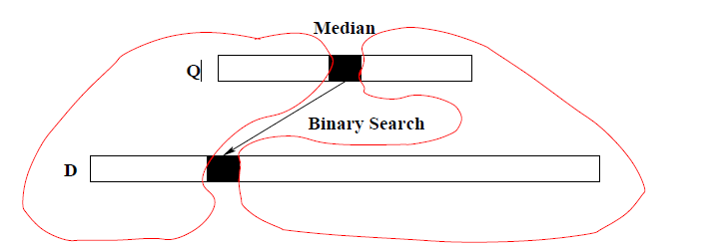
A Simple but Good Average Case Algorithm
Double Binary Search: Can be seen as a balanced version of Hwang and Lin’s algorithm adapted to set intersection.
Solve both sub-problems(merging & Bin Search) recursively.
i.e by exchange Q and D if |Q|> |D|.

Slide 11
Improvements
Small improvements in theory:
We compare the smallest elements of both sets with the largest elements in both sets, is O(1).
Otherwise, we search the smallest and largest element of D in Q, to find the real overlap, using just time O(lg m).
Doing the opposite is not worth it for small .

Slide 12
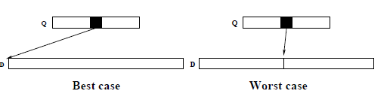
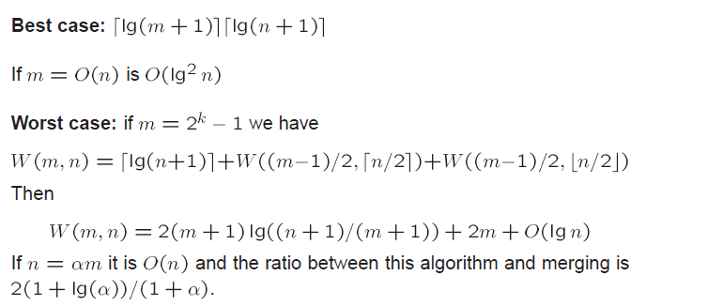
Analysis

Slide 13
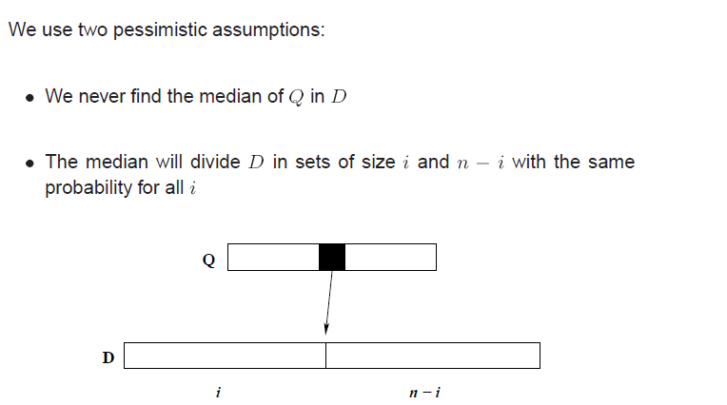
Average Case Analysis (1)

Slide 14
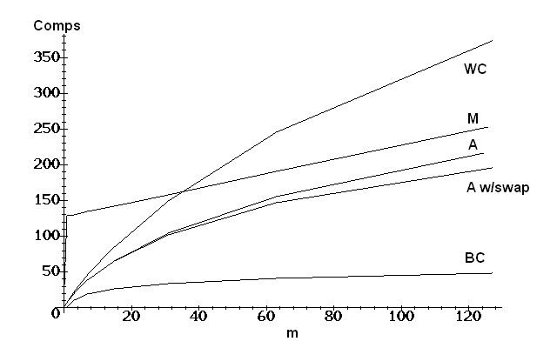
Actual comparisons of cases
For n=128 and all powers of 2 for m≤n.
Number of comparisons in the best, worst and average case (with and without swaps) for n = 128, as well as for merging (M)

Slide 15
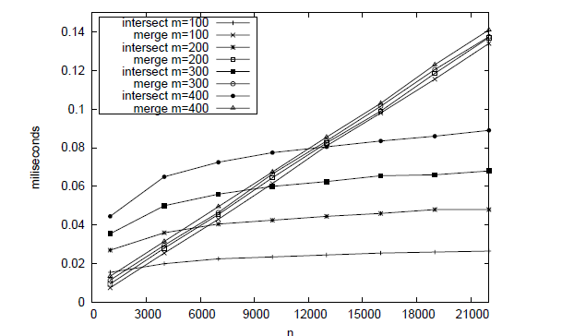
Experimental Results
We use uniformly random integer numbers in the range 1 to and we implemented the algorithms using the Gcc 3.3.3* compiler in a Linux platform running on an Intel Xeon of 3GHz.

Slide 16
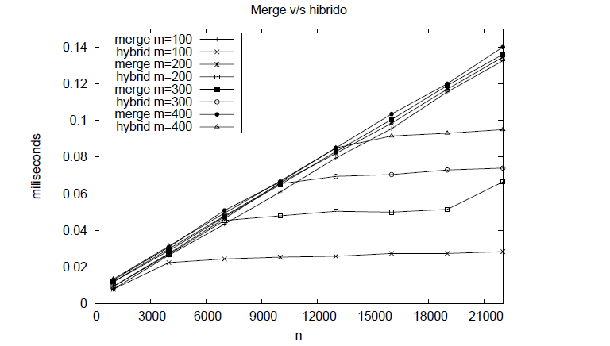
Hybrid Algorithm
When merge is better, stop the recursion. We found the empirical line when this happens in our implementation.

Slide 17
Query Processing in Inverted Indexes
Inverted indexes are a vocabulary and a list of references per word to its occurrences in documents and optionally to where they occur per document (full inversion)
Lists usually use linked blocks of references (variable size)
The references are sorted in:
Boolean model: intersection is basic for set operations
Vectorial model: by chunks of doc-ids with similar term-frequency
Word positions per document: shifted intersection
(full inversion, needed for phrase search)
Proximity search: that is i±k

Slide 18
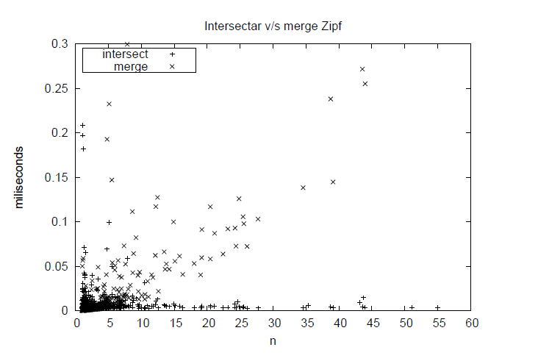
Intersection vs Merge

Slide 19
ALGORITHM
Intersect(D, Q, minD,maxD, minQ,maxQ)
1. //if Q or D are empty, we finish the recursion
2. if minD > maxD bfor minQ > maxQ
3. return ∅
4. miqQ ← round((minQ + maxQ)/2)
5. midQval ← Q[midQ]
6. midD ← binsearch(midQval,D, minD,maxD)
7. if |D[minD..midD − 1]| > |Q[minQ..midQ − 1]| // subset(D) > subset(Q)
8. Result ← Result ∪ Intersect(D, Q,minD,midD − 1,minQ,midQ− 1)
9. else //we exchange the roles of D and Q
10. Result ← Result ∪ Intersect(Q,D, minQ,midQ − 1,minD,midD − 1)
11. if D[midD] == midQval
12. Result ← Result ∪ {midQval}
13. midD ← posModD − 1
14. if |D[midD + 1..maxD]| > |Q[midQ + 1..maxQ]|// subset(D) > subset(Q)
15. Result ← Result ∪ Iintersect(D, Q, midD,maxD, midQ + 1,maxQ)
16. else //we exchange the roles of D and Q
17. Result ← Result ∪ Intersect(Q,D, midQ + 1, maxQ, midD,maxD)
18. return Result

Slide 20
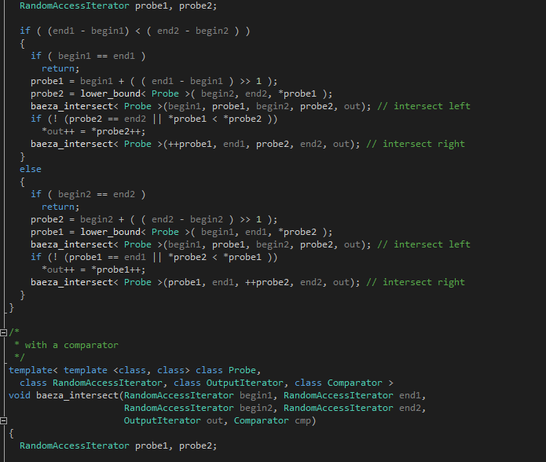
Implementation in C++

Slide 21
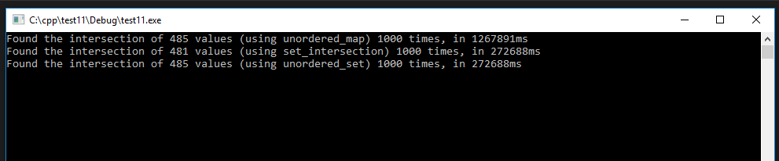
OUTPUT of C++ Code
For a large set of q=100000
And small set of d=1000

Slide 22
Output of Java Code
For a large set of q=100000
And small set of d=1000

Slide 23
Advantages
This Set intersection algorithm is a fundamental operation in information retrieval and database systems.
This algorithm shows the same times than Intersect in the section where the latter is better than Merge, combining the advantages of both algorithms in the best way.
It can used for both traditional AND-mode querying, and also in ranked querying environments when dynamic pruning techniques are used, or when pre-computed static scores such as PageRank contribute to answer ordering.

Slide 24
ISSUES while applying in web
Global ranking schemes (e.g. PageRank): document ids are defined by the ranking
The distribution of word occurrences is a power law, and the same is true with query frequencies.
Correlation is almost null.
That means that the average lengths of the lists, m and n, when sampled, will satisfy n=Ө(m)(uniform), rather than n= m+O(1)(power law).

Slide 25
Future Work
A simple way to improve this algorithm is to start to comparison of both the sets at the beginning to decide the smallest and by this we can save more time and execution will be very fast.

Slide 26
Concluding Remarks
In practice, Web queries are short: 1 to 3 words
Hence, there is almost no need to do multiset intersection and if so, they can be easily handled by pairing the smaller sets firsts.
We need partial evaluation, as most people only look at less than two result pages
Adaptive algorithm that finds first the first answers and in the right order?
That implies first to do the recursion on the left side.

Slide 27
THANK YOU

